Slide 1
Implementation III
Ed Angel
Professor of Computer Science, Electrical and Computer Engineering, and Media Arts
University of New Mexico

Slide 2
Objectives
Survey Line Drawing Algorithms
  DDA
  Bresenham
Angel: Interactive Computer Graphics 5E © Addison-Wesley 2009

Slide 3
Rasterization
Rasterization (scan conversion)
  Determine which pixels that are inside primitive specified by a set of vertices
  Produces a set of fragments
  Fragments have a location (pixel location) and other attributes such color and texture coordinates that are determined by interpolating values at vertices
Pixel colors determined later using color, texture, and other vertex properties
Angel: Interactive Computer Graphics 5E © Addison-Wesley 2009

Slide 4
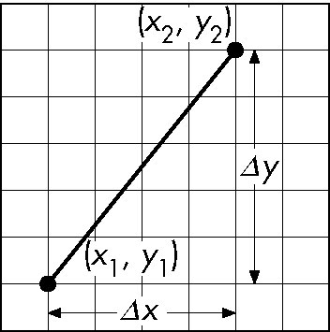
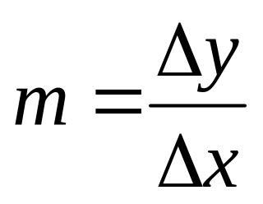
Scan Conversion of Line Segments
Start with line segment in window coordinates with integer values for endpoints
Assume implementation has a write_pixel function
y = mx + h
Angel: Interactive Computer Graphics 5E © Addison-Wesley 2009

Slide 5
DDA Algorithm
Digital Differential Analyzer
  DDA was a mechanical device for numerical solution of differential equations
  Line y=mx+ h satisfies differential equation
  dy/dx = m = Δy/Δx = y₂-y₁/x₂-x₁
Along scan line Δx = 1
For(x=x1; x<=x2,ix++) {
y+=m;
write_pixel(x, round(y), line_color)
}
Angel: Interactive Computer Graphics 5E © Addison-Wesley 2009

Slide 6
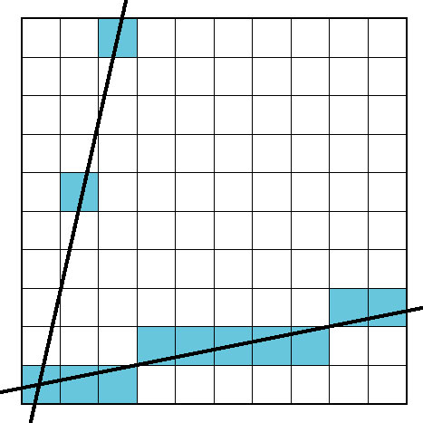
Problem
DDA = for each x plot pixel at closest y
  Problems for steep lines
Angel: Interactive Computer Graphics 5E © Addison-Wesley 2009

Slide 7
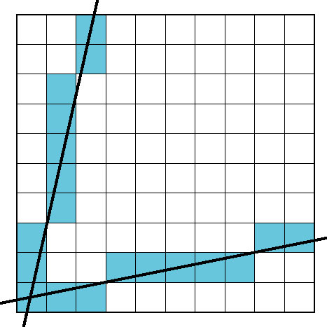
Using Symmetry
Use for 1 ≥ m ≥ 0
For m > 1, swap role of x and y
  For each y, plot closest x
Angel: Interactive Computer Graphics 5E © Addison-Wesley 2009

Slide 8
Bresenham’s Algorithm
DDA requires one floating point addition per step
We can eliminate all fp through Bresenham’s algorithm
Consider only 1 ≥ m ≥ 0
  Other cases by symmetry
Assume pixel centers are at half integers
If we start at a pixel that has been written, there are only two candidates for the next pixel to be written into the frame buffer
Angel: Interactive Computer Graphics 5E © Addison-Wesley 2009

Slide 9
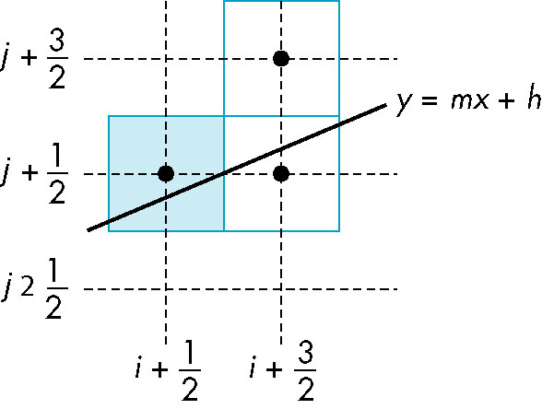
Candidate Pixels
1 ≥ m ≥ 0
candidates
last pixel
Note that line could have
passed through any
part of this pixel
Angel: Interactive Computer Graphics 5E © Addison-Wesley 2009

Slide 10
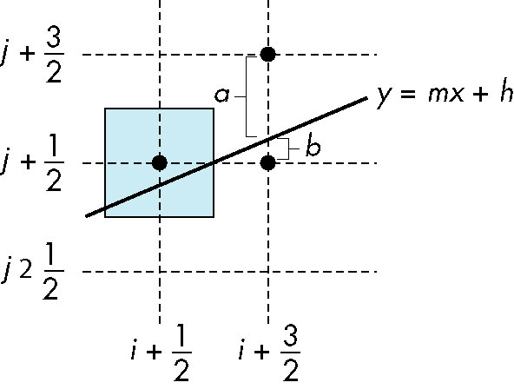
Decision Variable
d = Δx(b-a)
d is an integer
d > 0 use upper pixel
d < 0 use lower pixel
-
Angel: Interactive Computer Graphics 5E © Addison-Wesley 2009

Slide 11
Incremental Form
More efficient if we look at d_{k}, the value of the decision variable at x = k
d_{k+1}= d_{k} –2Δy, if d_{k} <0
d_{k+1}= d_{k} –2(Δy- Δx), otherwise
For each x, we need do only an integer
addition and a test
Single instruction on graphics chips
Angel: Interactive Computer Graphics 5E © Addison-Wesley 2009

Slide 12

Polygon Scan Conversion
Scan Conversion = Fill
How to tell inside from outside
  Convex easy
  Nonsimple difficult
  Odd even test
    Count edge crossings
  Winding number
odd-even fill
Angel: Interactive Computer Graphics 5E © Addison-Wesley 2009

Slide 13
Winding Number
Count clockwise encirclements of point
Alternate definition of inside: inside if winding number ≠ 0
winding number = 1
winding number = 2
Angel: Interactive Computer Graphics 5E © Addison-Wesley 2009

Slide 14
Filling in the Frame Buffer
Fill at end of pipeline
  Convex Polygons only
  Nonconvex polygons assumed to have been tessellated
  Shades (colors) have been computed for vertices (Gouraud shading)
  Combine with z-buffer algorithm
    March across scan lines interpolating shades
    Incremental work small
Angel: Interactive Computer Graphics 5E © Addison-Wesley 2009

Slide 15
Using Interpolation
C₁ C₂ C₃ specified by glColor or by vertex shading
C₄ determined by interpolating between C₁ and C₂
C₅ determined by interpolating between C₂ and C₃
interpolate between C₄ and C₅ along span
C₁
C₄
C₂
scan line
C₅
span
C₃
Angel: Interactive Computer Graphics 5E © Addison-Wesley 2009

Slide 16
Flood Fill
Fill can be done recursively if we know a seed point located inside (WHITE)
Scan convert edges into buffer in edge/inside color (BLACK)
flood_fill(int x, int y) {
if(read_pixel(x,y)= = WHITE) {
write_pixel(x,y,BLACK);
flood_fill(x-1, y);
flood_fill(x+1, y);
flood_fill(x, y+1);
flood_fill(x, y-1);
} }
Angel: Interactive Computer Graphics 5E © Addison-Wesley 2009

Slide 17
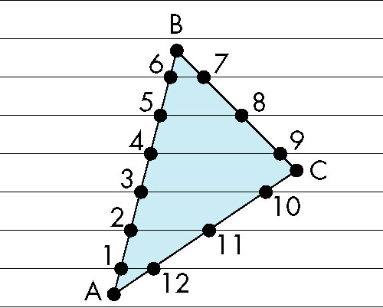
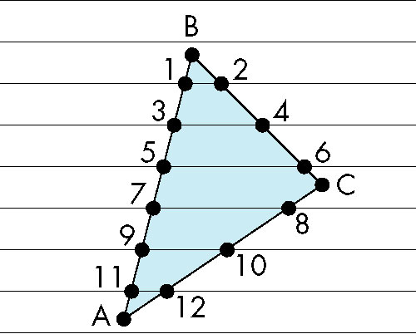
Scan Line Fill
Can also fill by maintaining a data structure of all intersections of polygons with scan lines
  Sort by scan line
  Fill each span
vertex order generated
by vertex list
desired order
Angel: Interactive Computer Graphics 5E © Addison-Wesley 2009

Slide 18
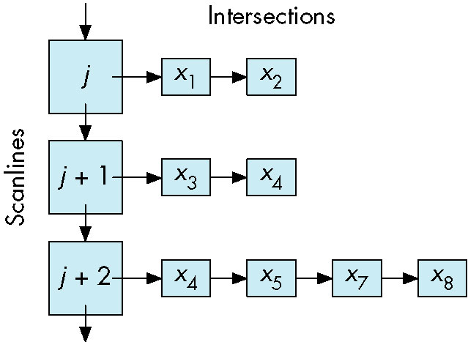
Data Structure
Angel: Interactive Computer Graphics 5E © Addison-Wesley 2009

Slide 19
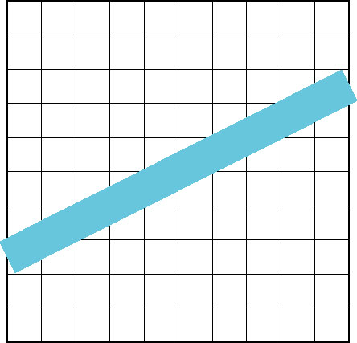
Aliasing
Ideal rasterized line should be 1 pixel wide
Choosing best y for each x (or visa versa) produces aliased raster lines
Angel: Interactive Computer Graphics 5E © Addison-Wesley 2009

Slide 20
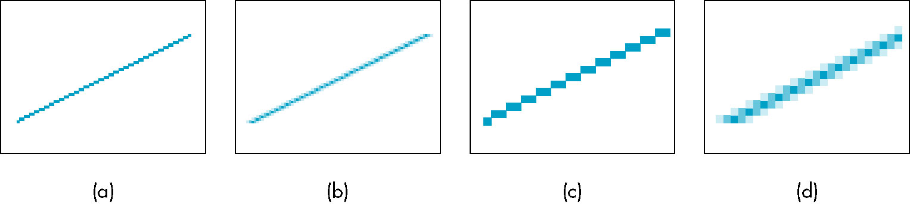
Antialiasing by Area Averaging
Color multiple pixels for each x depending on coverage by ideal line
original
antialiased
magnified
Angel: Interactive Computer Graphics 5E © Addison-Wesley 2009

Slide 21
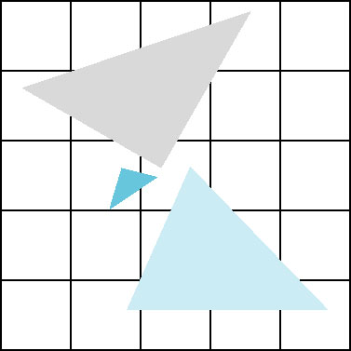
Polygon Aliasing
Aliasing problems can be serious for polygons
  Jaggedness of edges
  Small polygons neglected
  Need compositing so color
  of one polygon does not
  totally determine color of
  pixel
All three polygons should contribute to color
Angel: Interactive Computer Graphics 5E © Addison-Wesley 2009

